Slide 1
PART 3:
CONVERSATIONAL RECOMMENDER SYSTEM
Nguyễn Ngọc Song Thương - 2252803
Nguyễn Lê Vân Tú - 2252881
50

Slide 2
01
INTRODUCTION TO CONVERSATIONAL RECOMMENDER SYSTEM
LIST OF CONTENTS
02
METHODOLOGY: TGREDIAL
03
EXPERIMENTAL SETUP AND RESULTS
04
COMPARE WITH EAR
05
CONCLUSION & FUTURE WORKS
51

Slide 3
1
INTRODUCTION TO
CONVERSATIONAL RECOMMENDER SYSTEM
52

Slide 4
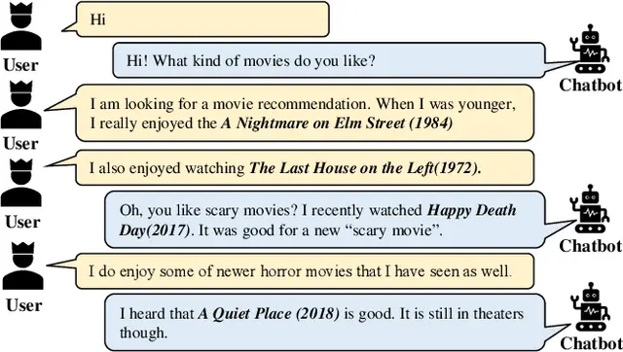
INTRODUCTION TO
CONVERSATIONAL RECOMMENDER SYSTEM (CRS)
A Conversational Recommender System (CRS) is an interactive system designed to provide personalized recommendations to users through natural language conversations.
53

Slide 5
PROMINENT RESEARCH DIRECTION IN CRS
ATTRIBUTE-BASED
GENERATION-BASED
Elicits preferences on item features via structured questions to filter recommendations
(e.g., "Genre: action or comedy?")
Uses end-to-end models to generate natural dialogue and recommendations based on conversation context.
(e.g. recommend, chit chat,..)
54

Slide 6
2
METHODOLOGY:
TGREDIAL
55

Slide 7
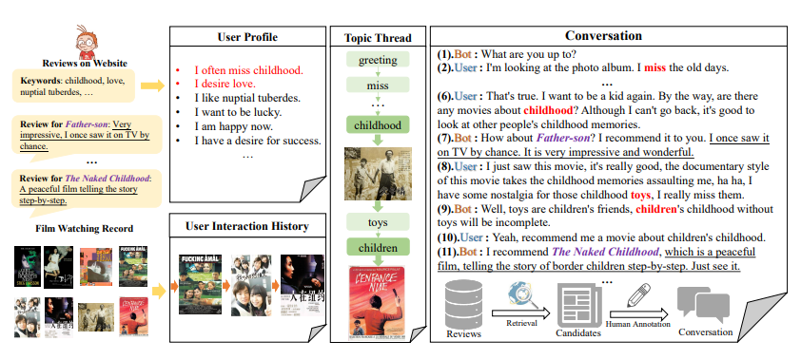
TGREDIAL
TOWARDS TOPIC-GUIDED
CONVERSATIONAL RECOMMENDER SYSTEM
Figure 3.1. An illustrative example for TGReDial dataset. Src: https://aclanthology.org/2020.coling-main.365/
56

Slide 8
TGREDIAL
TOWARDS TOPIC-GUIDED
CONVERSATIONAL RECOMMENDER SYSTEM
Generation-based
Modular approach
Topic annotations
Real user association
User history
57

Slide 9
TGREDIAL
BENCHMARK SOLUTION: RECOMMENDER
User 100:
“Any movie about childhood?”
BERT[4]
Similarity scoring and ranking with movie embeddings
v1 - context emb
MLP
User 100
interaction history:
Movie 1
Movie 2
...
Movie 10
u - user representation
SASREC[3]
v2 - inter emb
58

Slide 10
TGREDIAL
BENCHMARK SOLUTION: TOPIC PREDICTION
Historical utterance
CONV-BERT
Historical topic sequence
TOPIC-BERT
Similarity scoring and ranking with topic embeddings
MLP
topic representation
User profile
PROFILE-BERT
59

Slide 11
TGREDIAL
BENCHMARK SOLUTION: RESPOND GENERATION
Predicted topic
CONCATENATE
GPT-2 [6]
Historical utterance
CONCATENATE
GPT-2
Recommended item
60

Slide 12
3
EXPERIMENTAL SETUP
AND RESULT
61

Slide 13
DATASET: TGREDIAL - EXAMPLE
{ 'conv_id': 100,
'messages': [
{'local_id': 1, 'role': 'Recommender', 'content': 'What are you busy with?'},
{'local_id': 2, 'role': 'Seeker', 'content': 'I've been very confused recently, because of the ideal that is being eaten away. '},
{'local_id': 3, 'role': 'Recommender', 'content': 'Yeah, ideals are all dreamy and beautiful, but reality is very skinny. '},
{'local_id': 4, 'role': 'Seeker', 'content': 'Yes, the dream is too beautiful, just like a fairy tale. '},
{'local_id': 5, 'role': 'Recommender', 'content': 'I recommend you to watch a movie about fairy tales to relax your mood, for example, you can watch "Enchanted", it's very good, our lives really need fairy tales~'},
{'local_id': 6, 'role': 'Seeker', 'content': 'Yes, it's more fairy-tale than I thought, hahaha. '},
...],
'goal_path': {
2: ['Seeker', 'Talk', 'Ideal'],
3: ['Rec', 'Talk', 'Dream'],
4: ['Seeker', 'Talk', 'Fairy Tale'],
5: ['Rec', 'Request Recommendation', ['Fairy Tale'], 'Recommended Movie', 'Enchanted'],
6: ['Seeker', 'Feedback', None],...},
'mentionMovies': {5: ['1971111', 'Enchanted(0)'],...},
'user_id': '1'}
62

Slide 14
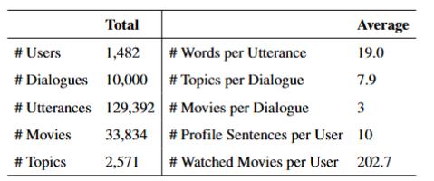
DATASET: TGREDIAL
Table 3.2. TGRedial statistics
63

Slide 15
CRSLAB
TG-REC
TG-REC with
pretrained SASREC
Standalone SASREC
  Learn movie embeddings from User interaction history only
  Not applicable to CRS
  Learn movie embeddings from both user history and ongoing conversation
  Pretrained SASREC learned movie embeddings through user browsing interaction
  Only MLP layer adapts to fuse conversation context with learned movie embeddings
64

Slide 16
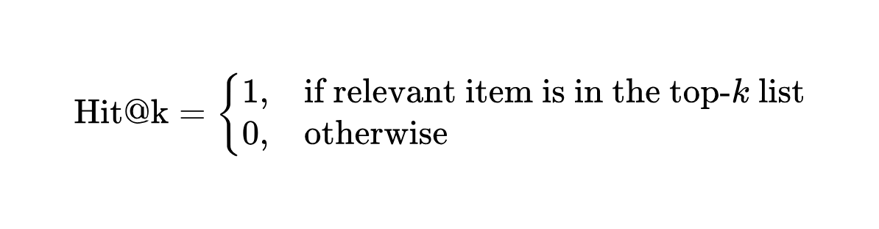
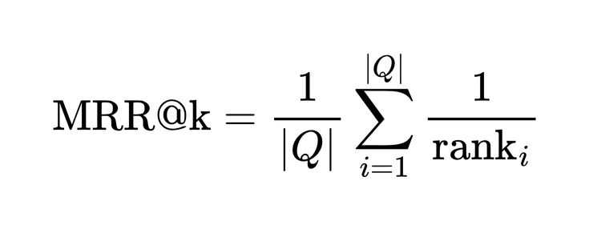
EVALUATION METRICS
(TOP-K)
  Hit Rate (Hit@k): grouth truth’s presence in the top-k recommended item
  Mean Reciprocal Rank (MRR@k): evaluate the rank of the first relevant item. The sooner, the better.
65

Slide 17
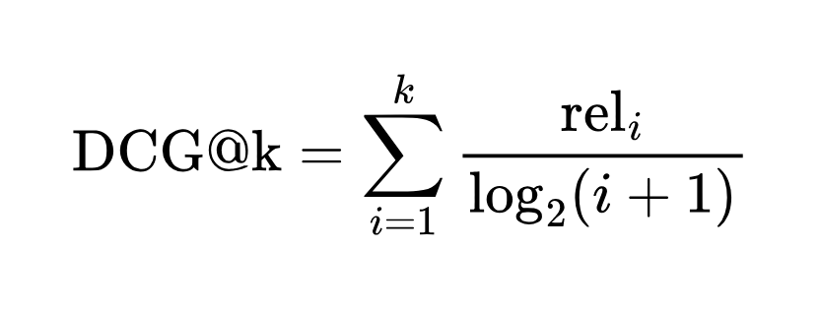
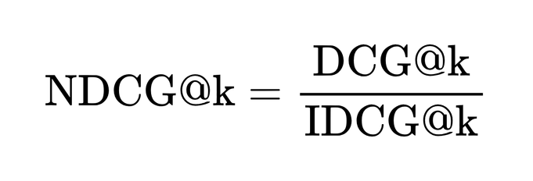
EVALUATION METRICS
(TOP-K)
  Normalized Discounted Cumulative Gain (NDCG@k): how good the ranking is
66

Slide 18
RESULT
 | NDCG@1 | NDCG@10 | NDCG@50 | MRR@1 | MRR@10 | MRR@50
TG-Rec (Paper) |  | 0.0348 | 0.0527 |  | 0.0240 | 0.0277
TG-Rec | 0.0150 | 0.0393 | 0.0644 | 0.0150 | 0.0289 | 0.0338
TG-Rec w/ pretrained SASREC | 0.0203 | 0.0427 | 0.0562 | 0.0203 | 0.0337 | 0.0365
 | HIT@1 | HIT@10 | HIT@50 | Loss
 | 0.0150 | 0.0740 | 0.1924 | 10.15
TG-Rec w/ pretrained SASREC | 0.0203 | 0.0720 | 0.1343 | 12.62
67

Slide 19
4
COMPARE WITH EAR
68

Slide 20
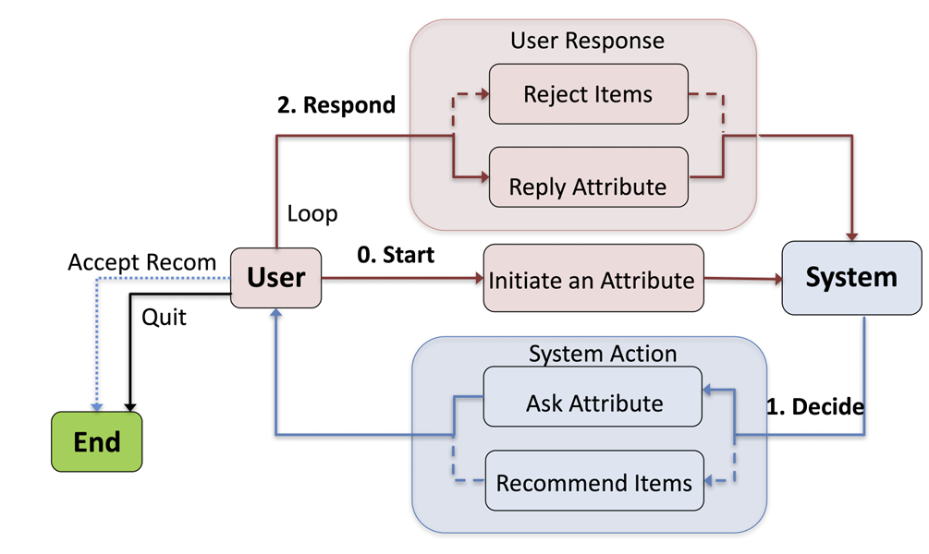
COMPARE WITH EAR
Figure 3.2. Workflow of EAR. [5]
69

Slide 21
5
CONCLUSION AND
FUTURE WORKS
70

Slide 22
CONCLUSION
FUTURE WORKS
  Pretrained SASRec boosts TG-Rec efficiency
  Leveraging prior knowledge is beneficial for CRS.
  Leverage LLMs for language understanding in CRS
  Shift to one-time training of the whole system instead of training separate modules.
  Guided conversation: Gradually lead users to relevant product suggestions.
71

Slide 23
REFERENCES
  Kun Zhou et al. “Towards Topic-Guided Conversational Recommender System”. In: Proceedings of the 28th International Conference on Com-putational Linguistics. Ed. by Donia Scott, Nuria Bel, and Chengqing Zong. Barcelona, Spain (Online): International Committee on Computational Linguistics, Dec. 2020, pp. 4128–4139. Access: https://aclanthology.org/2020.coling-main.365.pdf
  Kun Zhou et al. “CRSLab: An Open-Source Toolkit for Building Con-versational Recommender System”. In: Proceedings of the 59th Annual Meeting of the Association for Computational Linguistics and the 11th International Joint Conference on Natural Language Processing: System Demonstrations. Ed. by Heng Ji, Jong C. Park, and Rui Xia. Online: Association for Computational Linguistics, Aug. 2021, pp. 185–193. Access: https://github.com/RUCAIBox/CRSLab
  Wang-Cheng Kang and Julian McAuley. “Self-Attentive Sequential Recommendation”. In: 2018 IEEE International Conference on Data Mining (ICDM). Los Alamitos, CA, USA: IEEE Computer Society, Nov. 2018, pp. 197–206
  Jacob Devlin, Ming-Wei Chang, Kenton Lee, and Kristina Toutanova. 2019. BERT: pre-training of deep bidirectional transformers for language understanding. In Proceedings of the 2019 Conference of the North American Chapter of the Association for Computational Linguistics: Human Language Technologies, NAACL-HLT 2019, Minneapolis, MN, USA, June 2-7, 2019, Volume 1 (Long and Short Papers), pages 4171–4186
  Radford, A., Wu, J., Child, R., Luan, D., Amodei, D. & Sutskever, I. (2019). Language Models are Unsupervised Multitask Learners. OpenAI, .
  Lei, W., He, X., Miao, Y., Wu, Q., Hong, R., Kan, M. Y., & Chua, T. S. (2020, January). Estimation-action-reflection: Towards deep interaction between conversational and recommender systems. In Proceedings of the 13th international conference on web search and data mining (pp. 304-312).
72

Slide 24
THANKS
FOR WATCHING
73

